Slide 1
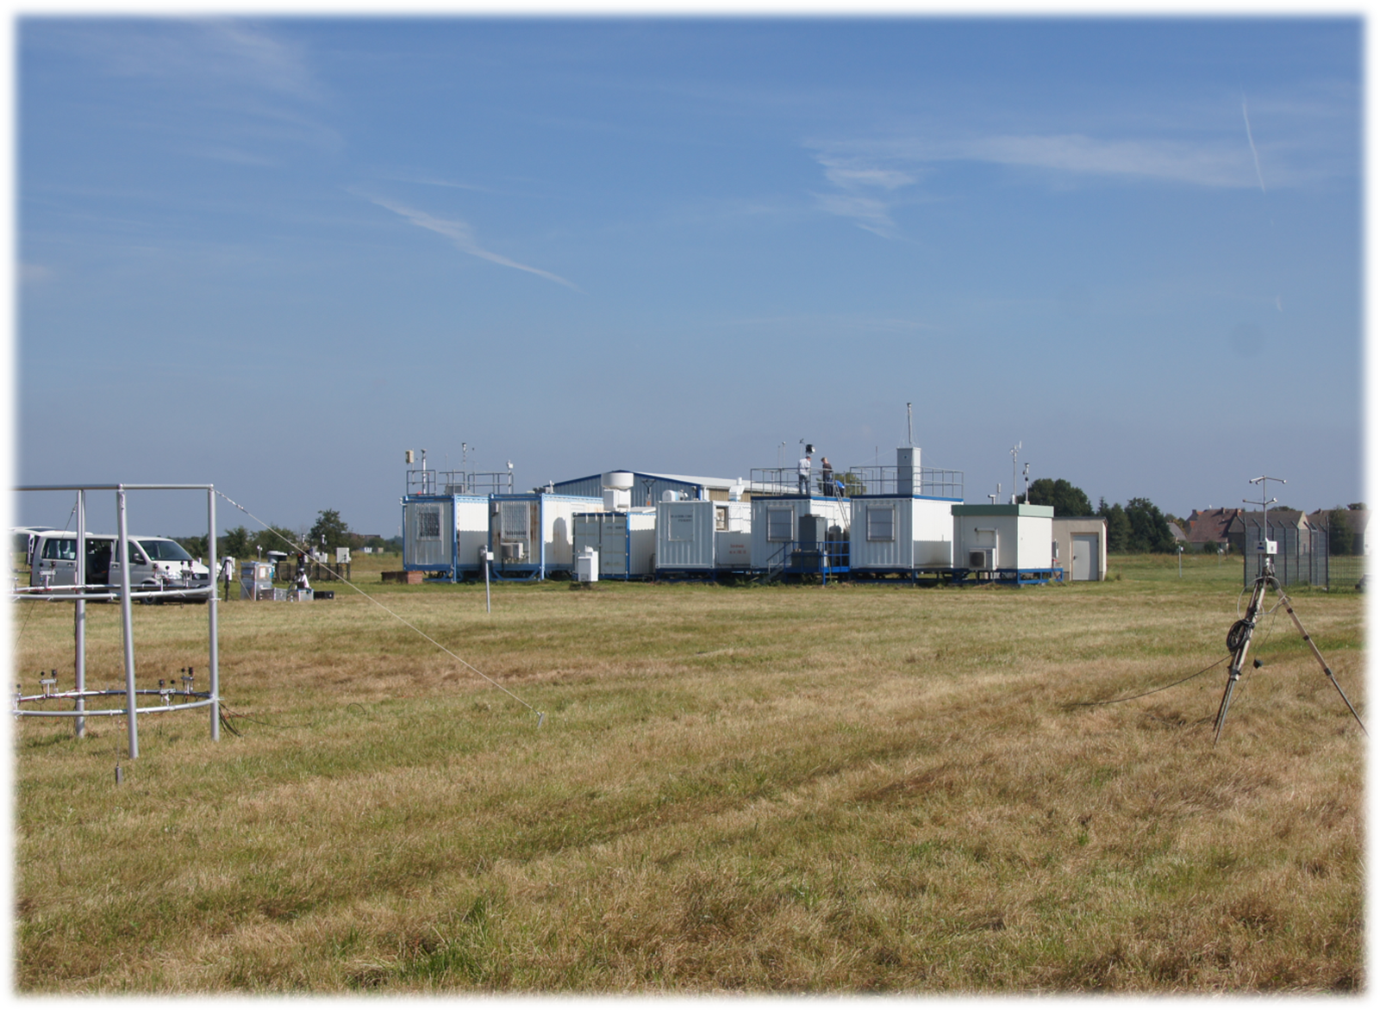



A twenty-one year long-term trend for
PM10 and PM2.5 at Melpitz site in Germany –
infuence of air mass inflow and season
G. Spindler, A. Grüner, Y. Iinuma, K. Müller, B.Stieger and H. Herrmann
CONVENTION ON LONG-RANGE TRANSBOUNDARY AIR POLLUTION
16th Task Force on
Measurement and Modelling Meeting
Cracow (Poland), 5 – 8 May 2015

Slide 2

Content
The Melpitz site – location
Daily sampling and analysis of PM₁₀, PM_{2.5} (and PM₁)
The long-term HV dataset
Analysis of particle samples
Classification of sampling days
Twenty-one-year PM₁₀ measurements (Examples)
for all days
for classes of days (air mass inflow and season)
for classes of month JFM, AMJ, JAS and OND
for week days
Summary and outlook

Slide 3










Location of the TROPOS research site in Europe
maritime
air masses
Continental
air masses
Melpitz site
(12°56‘ E, 51°32‘ N,
altitude 86 m
above sea level)
Cracow

Slide 4
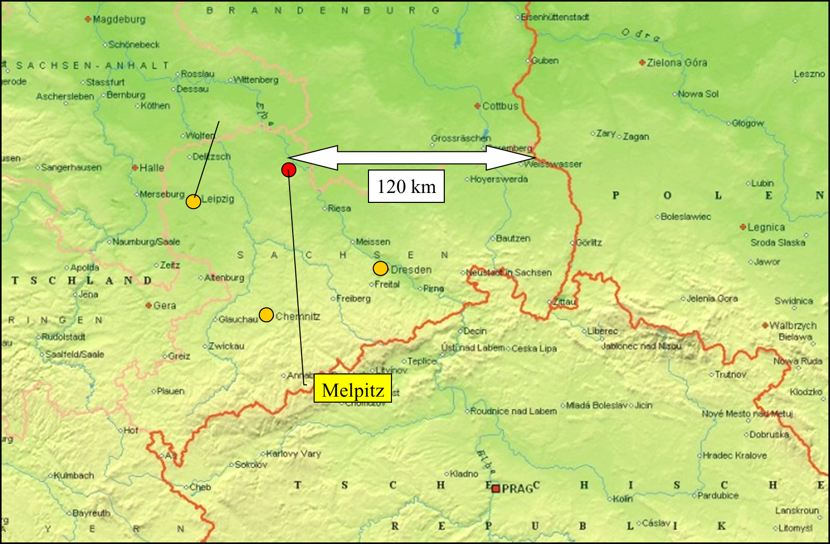

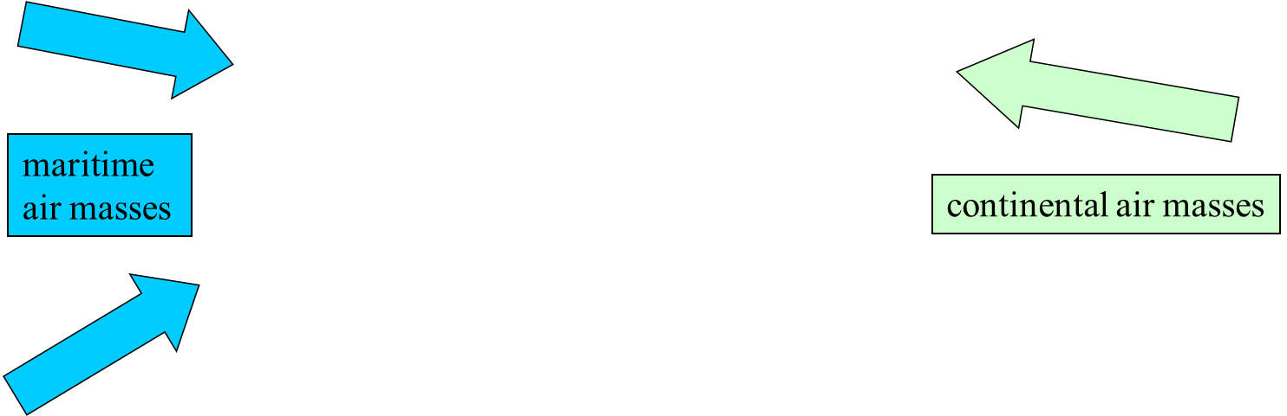
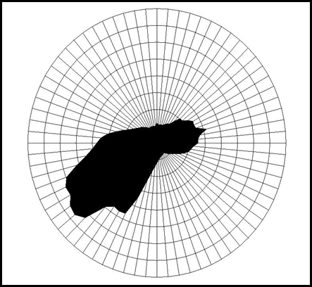
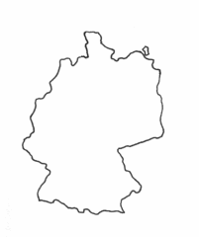
Location of the IfT research site in Germany (state of Saxony)
Melpitz site
(12°56‘ E, 51°32‘ N,
altitude 86 m
above sea level)

Slide 5
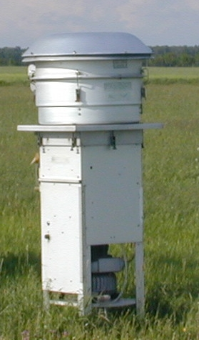
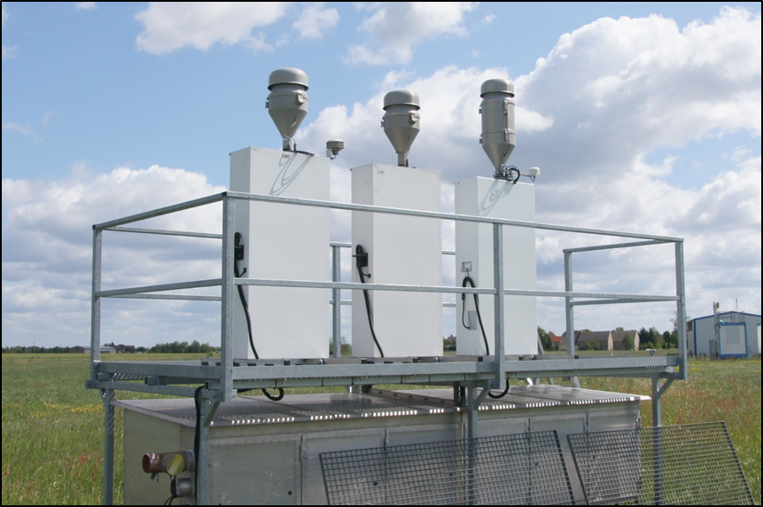
PM High Volume (HV) Sampler,
Quartz-filters
Sierra Andersen
Sammler 1000 l/min⁻¹
PM₁₀ 11/1992-12/2002
Digitel DHA-80
Sammler 500 l/min⁻¹
PM₁₀, PM_{2.5}, PM₁ 01/2003-12/2014
11/1992 2002|2003 12/2014 8096 Tage
PM₁₀ 94.2 %
PM_{2.5} 96.4 %
PM₁ 22.4 %
daily
daily
daily
every 6th day

Slide 6
The long-time data set for Melpitz DE44
Availability for mass detection % of days in year
1993 1994 1995 1996 1997 1998 1999 2000
PM₁₀ 85.5 99.5 96.2 99.7 97.8 97.5 92.3 95.9
PM_{2.5} 0 0 0 0 0 0 0 0
2001 2002 2003 2004 2005 2006 2007 2008
PM₁₀ 99.7 89.0 29.9 ^{*)} 99.2 98.4 99.5 100 99.7
PM_{2.5} 0 0 93.4 93.7 91.2 98.1 99.7 99.2
2009 2010 2011 2012 2013 2014
PM₁₀ 97.8 99.1 100 99.2 100 99.5
PM_{2.5} 88.5 95.3 99.7 99.2 100 98.6
*) from 12.02.2003 until 09.10.2003 no sampling for PM10

Slide 7
Gravimetric mass
Weighing with micro-balances (Mettler Toledo, Switzerland).
(50±5)% relative humidity and temperature (20±1) °C (conditioning time 48 hours).
Water soluble ions
Determination by standard ion chromatography after an aqueous extraction.
OC+EC=TC: Two-step-method (VDI 2465, page 2)
step: N₂-atmosphere 650 °C ⇒ organic carbon OC
step: O₂-atmosphere 650 °C ⇒ elemental carbon EC
Detection as CO₂ (IR) oxidation of C on a CuO-catalytic converter (850 °C)
Since 2012 additional bei a thermo-graphic analysis,
(Labanalyser Sunset Laboatory Inc., U.S.A.)
Temperature protocol EUSAAR2, Transmittance
Analysis of the samples

Slide 8

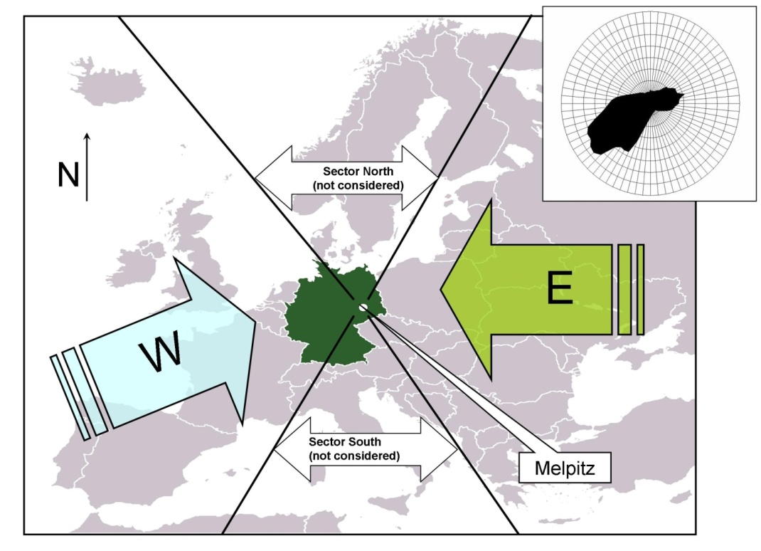
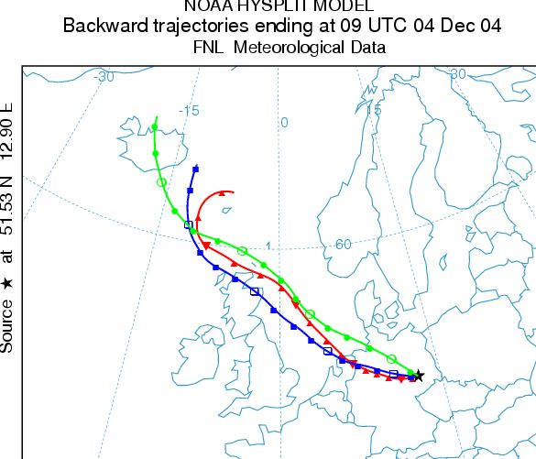
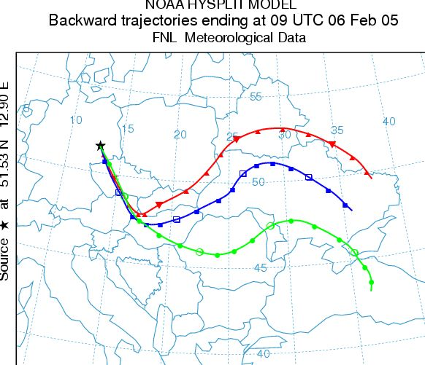
Categorization of measurement days
for air mass origin and season
air mass origin
Example sector WEST
210°-320°
Example sector EAST
35°-140°
96-hour backward trajectories for two times (10 and 18 o‘clock CET),
for 200, 500 und 1500 m over ground
source: http://www.arl.noaa.gov/ready/hysplit4.htm
WW WE
SW SE
53.3% 15.1%
season
Winter: November – April
Summer: May - October
68% of days
in categories
(11/1992 until 12/2014)

Slide 9
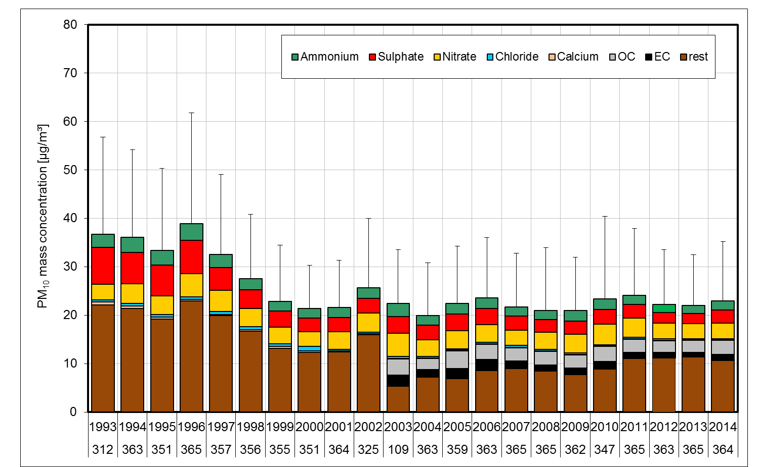
PM₁₀ concentration content of main
water soluble ions and carbon since 1993 (yearly means)
Mean yearly concentration (2000-2014)
(22.3 ± 2.9) µg/m³, variation ± 13%
Measuring
days
12.02.2003 until 09.10.2003 no sampling for PM10
The error bars are the positive standard deviation of
daily particle mass concentration means. For 2014 preliminary data.
HV-filter-sampler

Slide 10
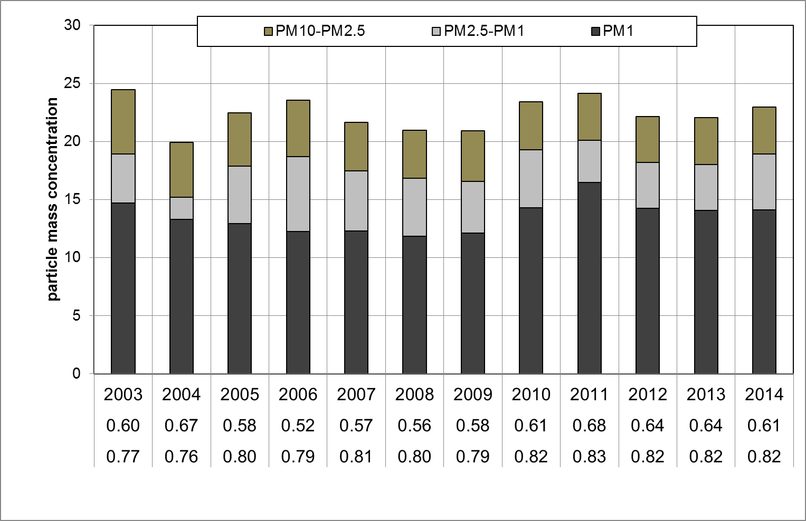


PM₁₀, PM_{2.5} and PM₁ concentration 2003 - 2014
(yearly means)
PM₁/PM₁₀
PM_{2.5}/PM₁₀

Slide 11
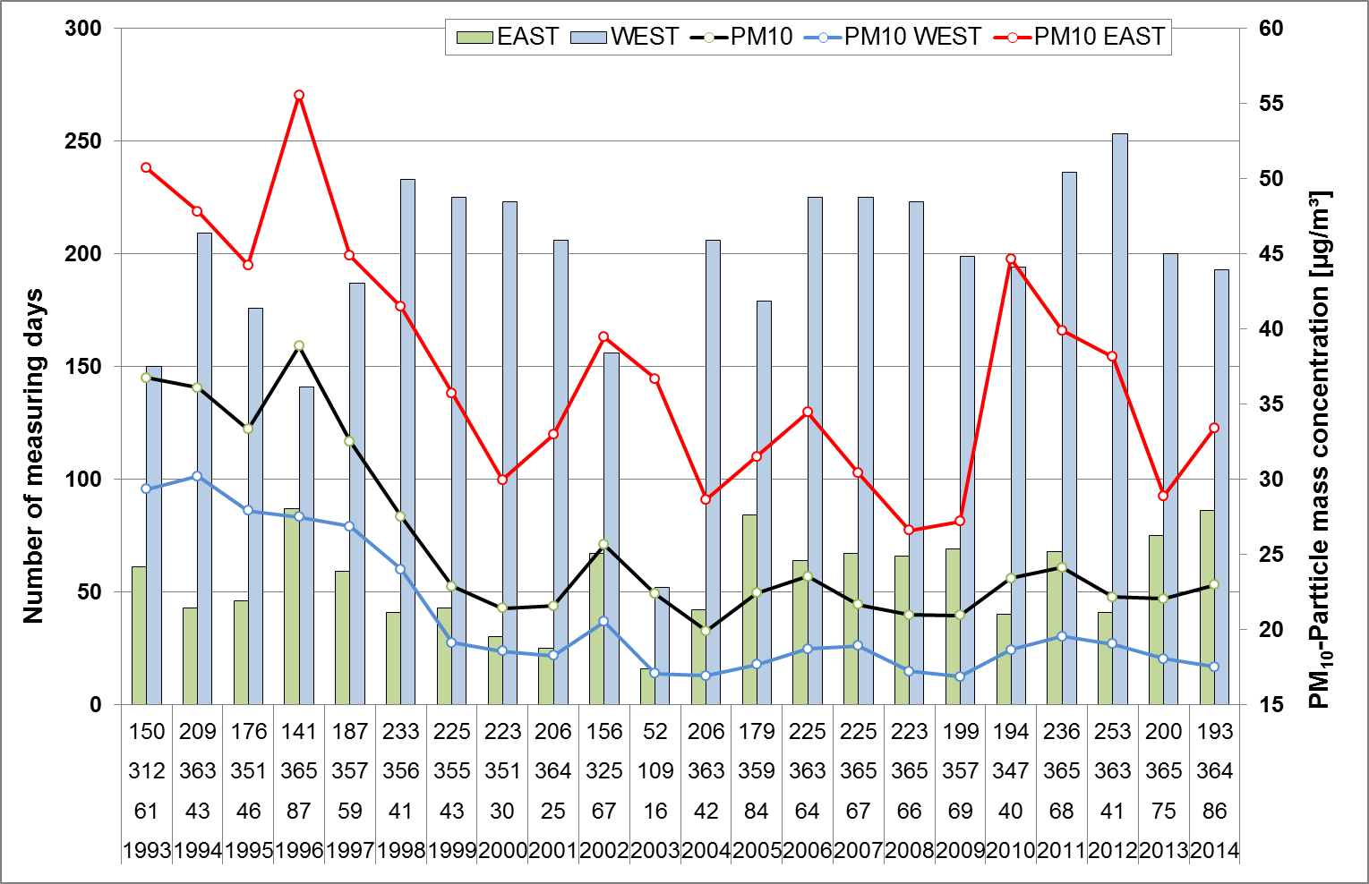
PM₁₀-Mass concentration -
yearly means for air mass inflow East and West

Slide 12
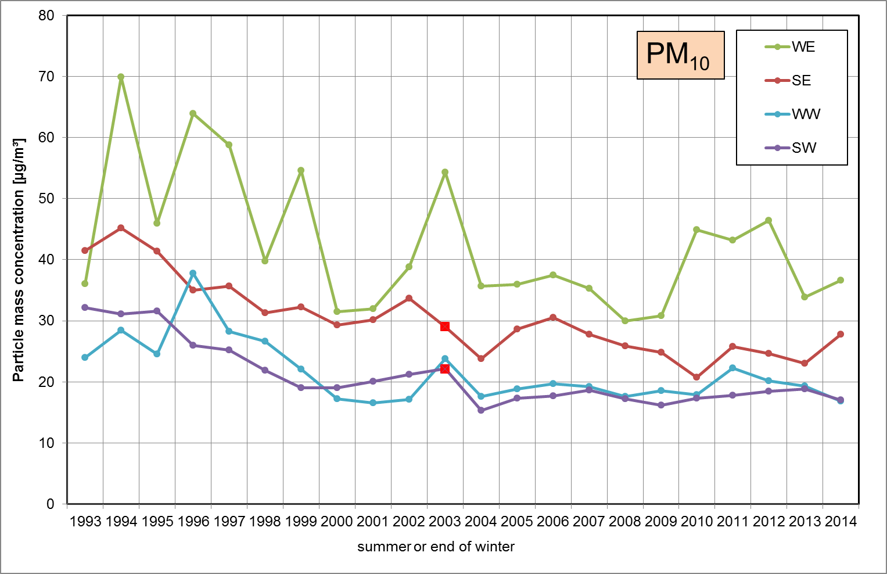
PM₁₀ mass concentration at Melpitz site 1993 - 2014
Mean for days with easterly air mass inflow
(winter and summer)
Mean for days with westerly air mass inflow
(winter and summer)

Slide 13
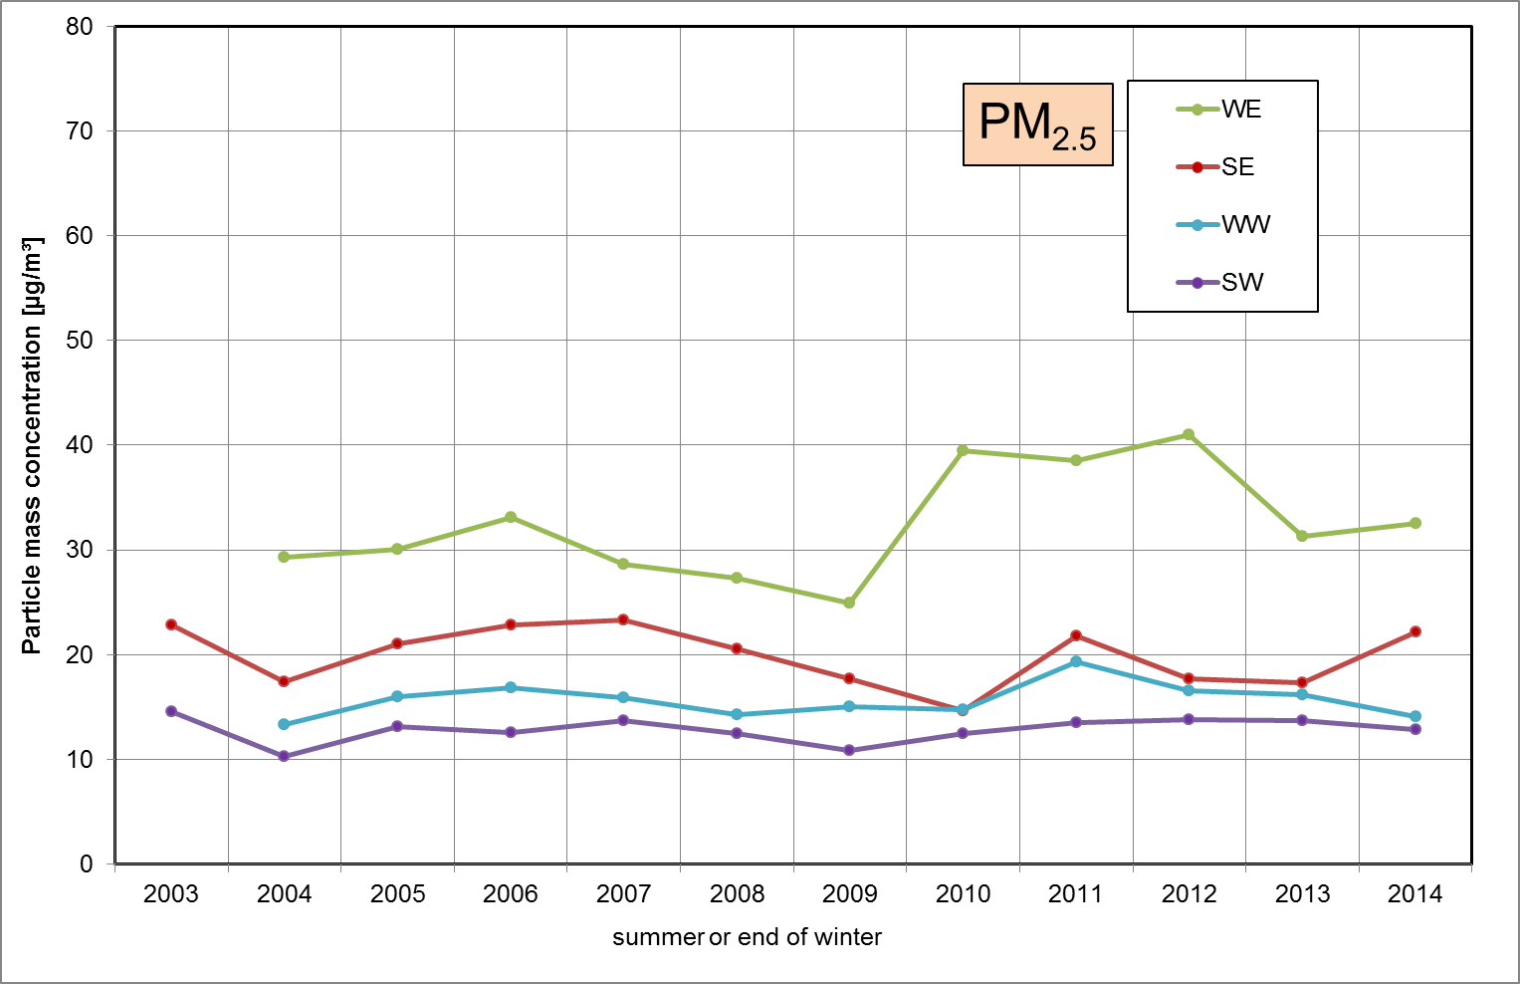
PM_{2.5} mass concentration at Melpitz site 2003 - 2014

Slide 14
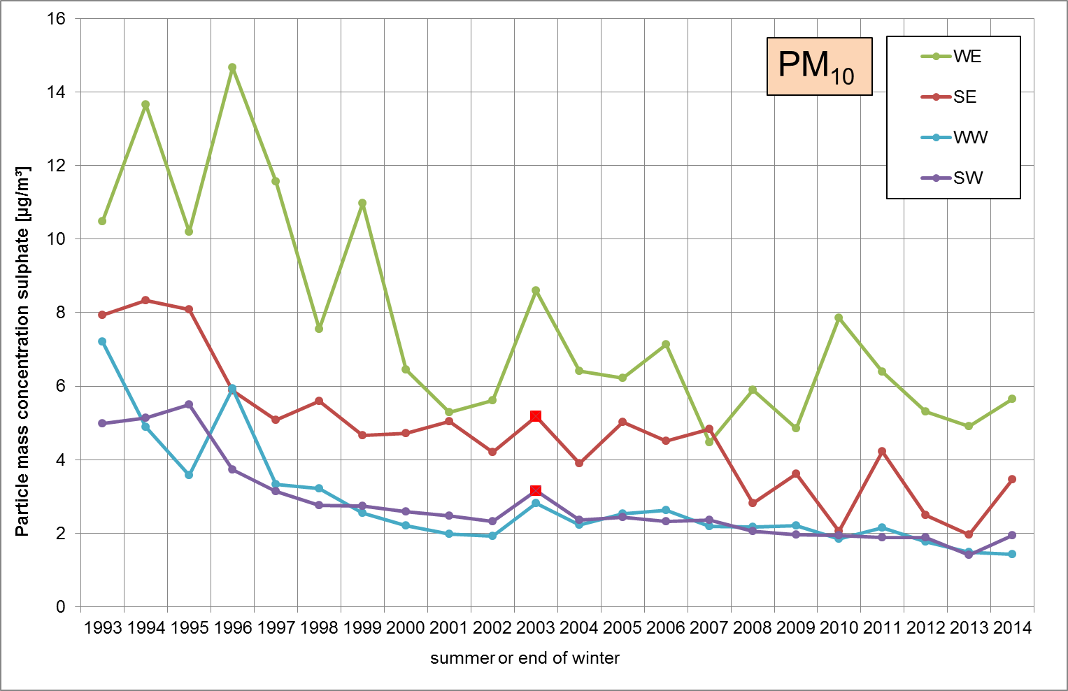
Sulphate mass concentration at Melpitz site 1993 - 2014

Slide 15
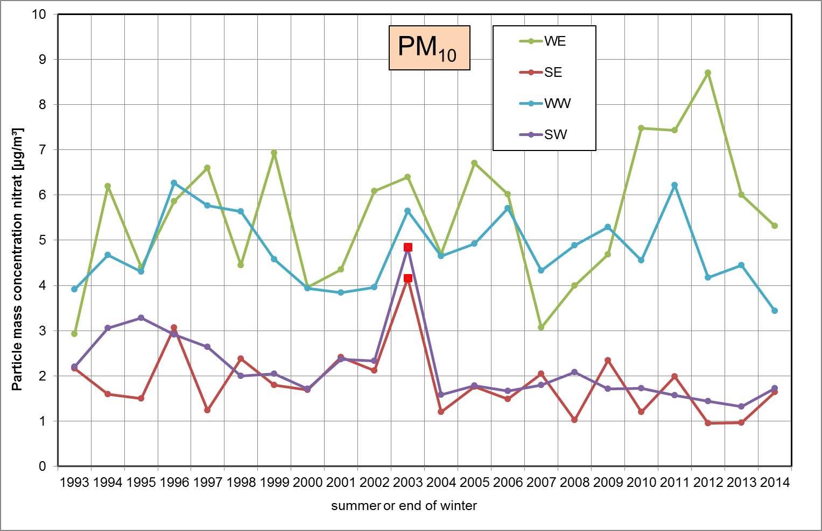
Nitrate mass concentration at Melpitz site 1993 - 2014

Slide 16
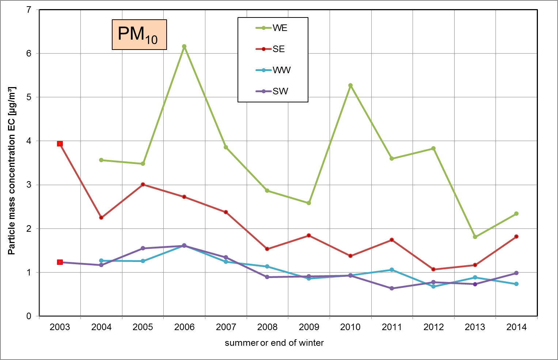
EC mass concentration at Melpitz site 2003 - 2014

Slide 17
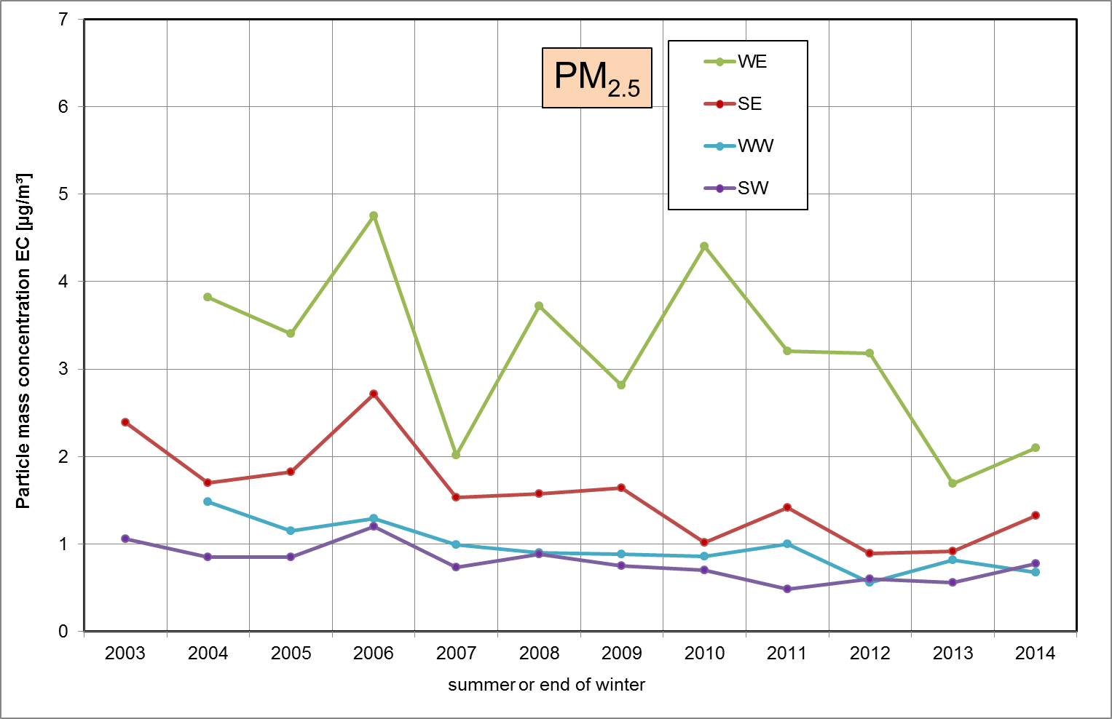
EC mass concentration at Melpitz site 2003 - 2014

Slide 18
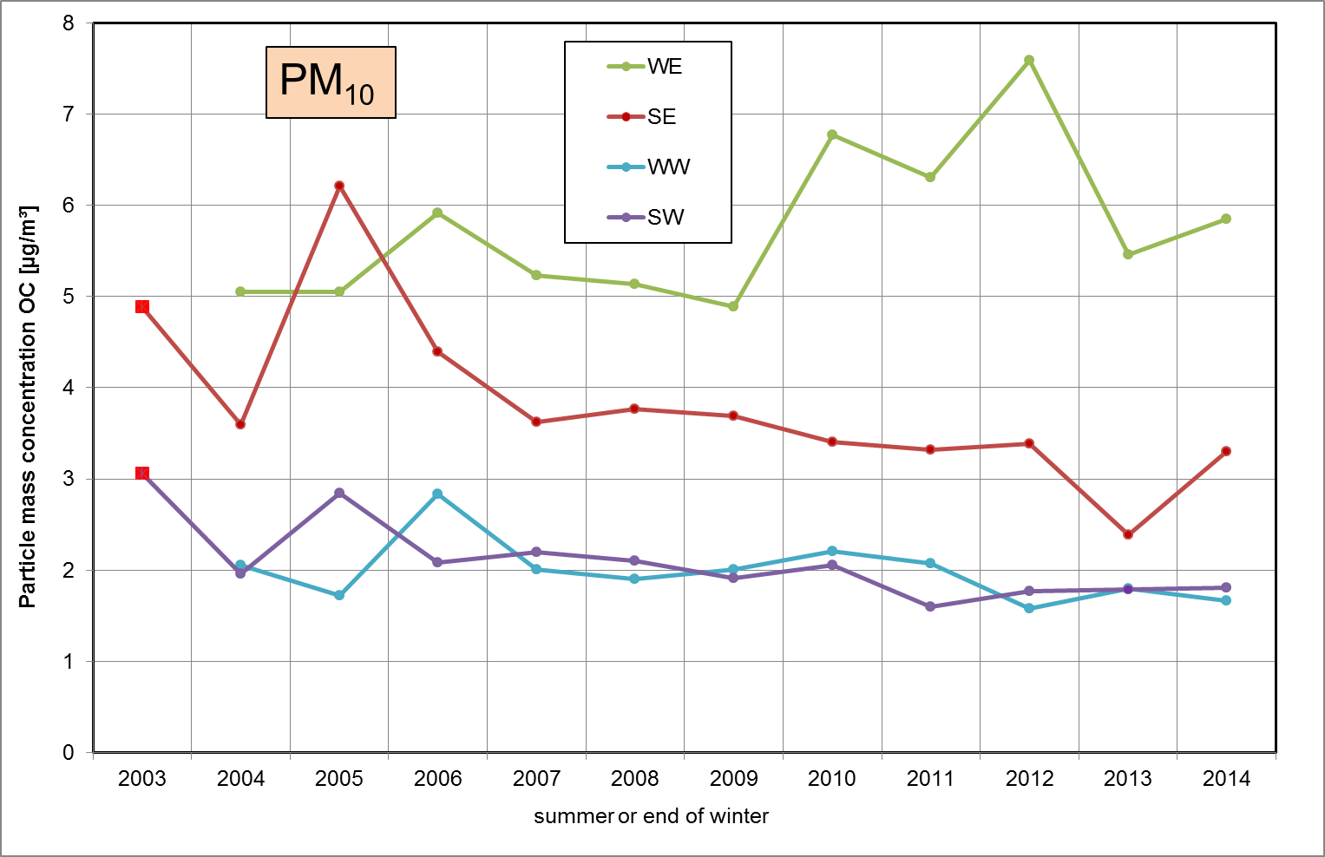
OC mass concentration at Melpitz site 2003 - 2014

Slide 19
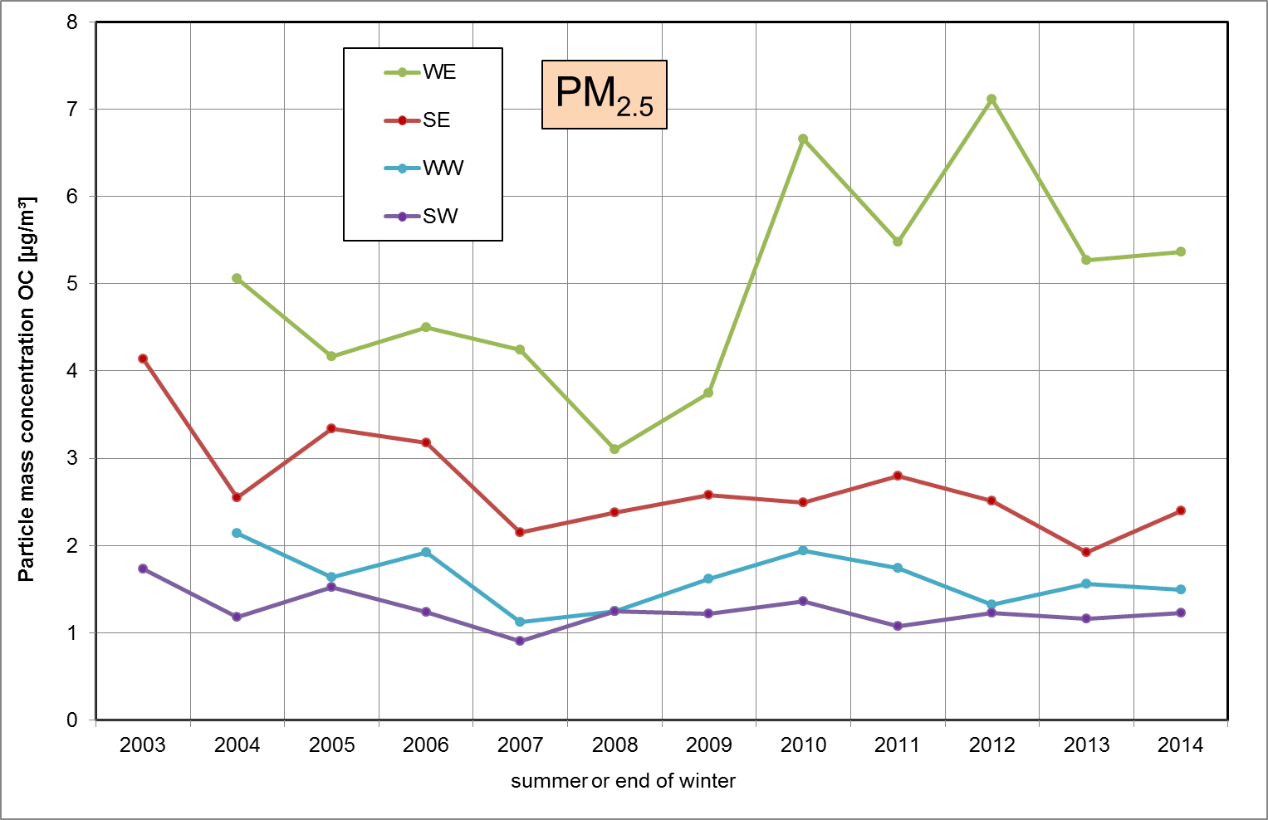
OC mass concentration at Melpitz site 2003 - 2014

Slide 20
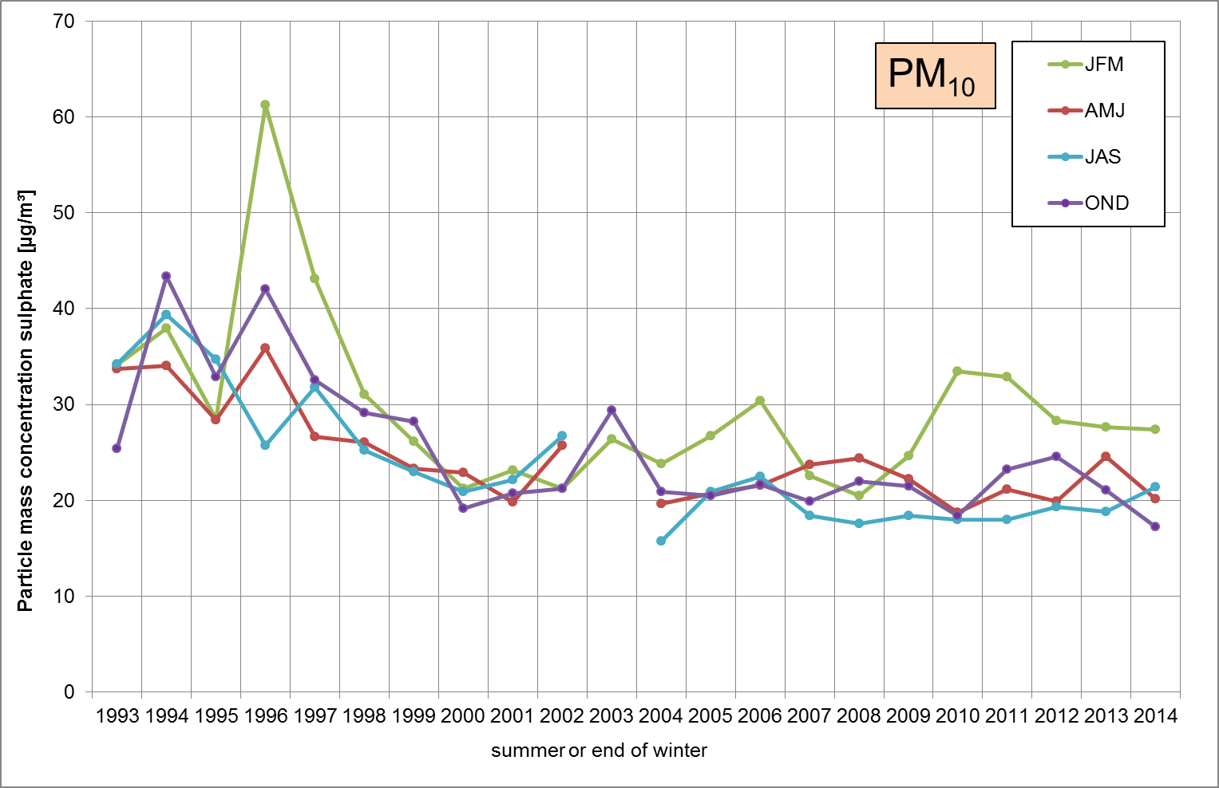
mass concentration at Melpitz site 1993 – 2014
(for quarterly periods)

Slide 21
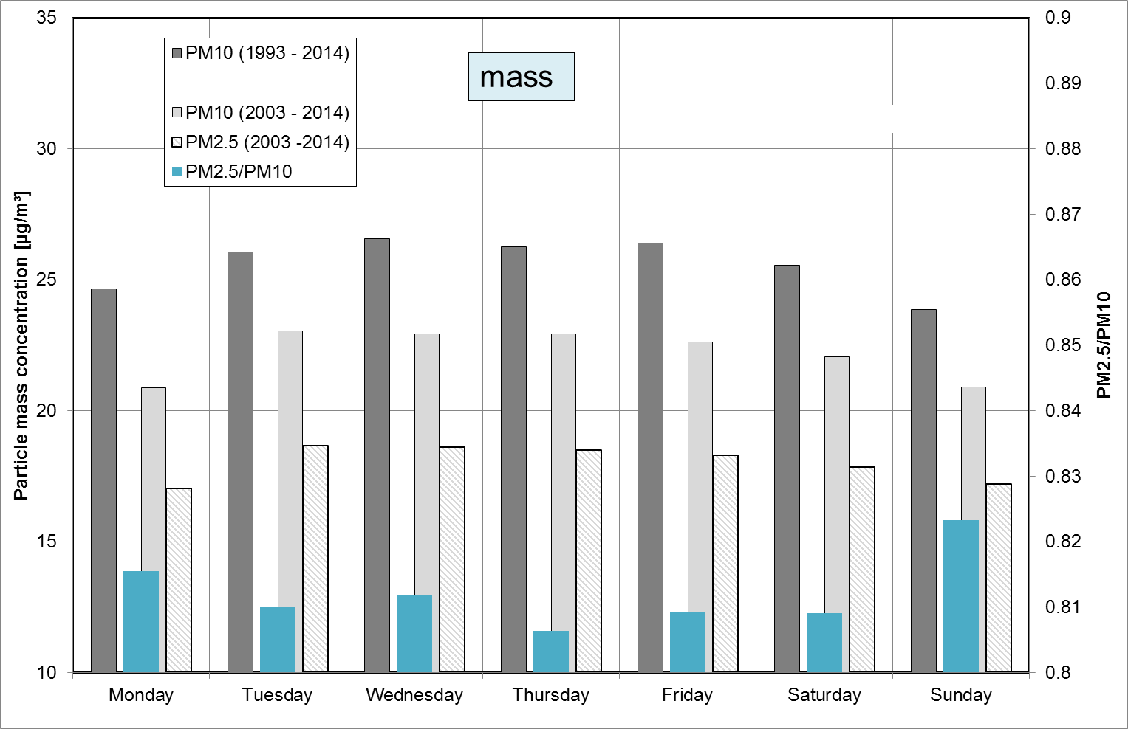
mass concentration average for week-days
1993 – 2014, PM₁₀ , 2003 – 2014 PM₁₀ and PM_{2.5}

Slide 22
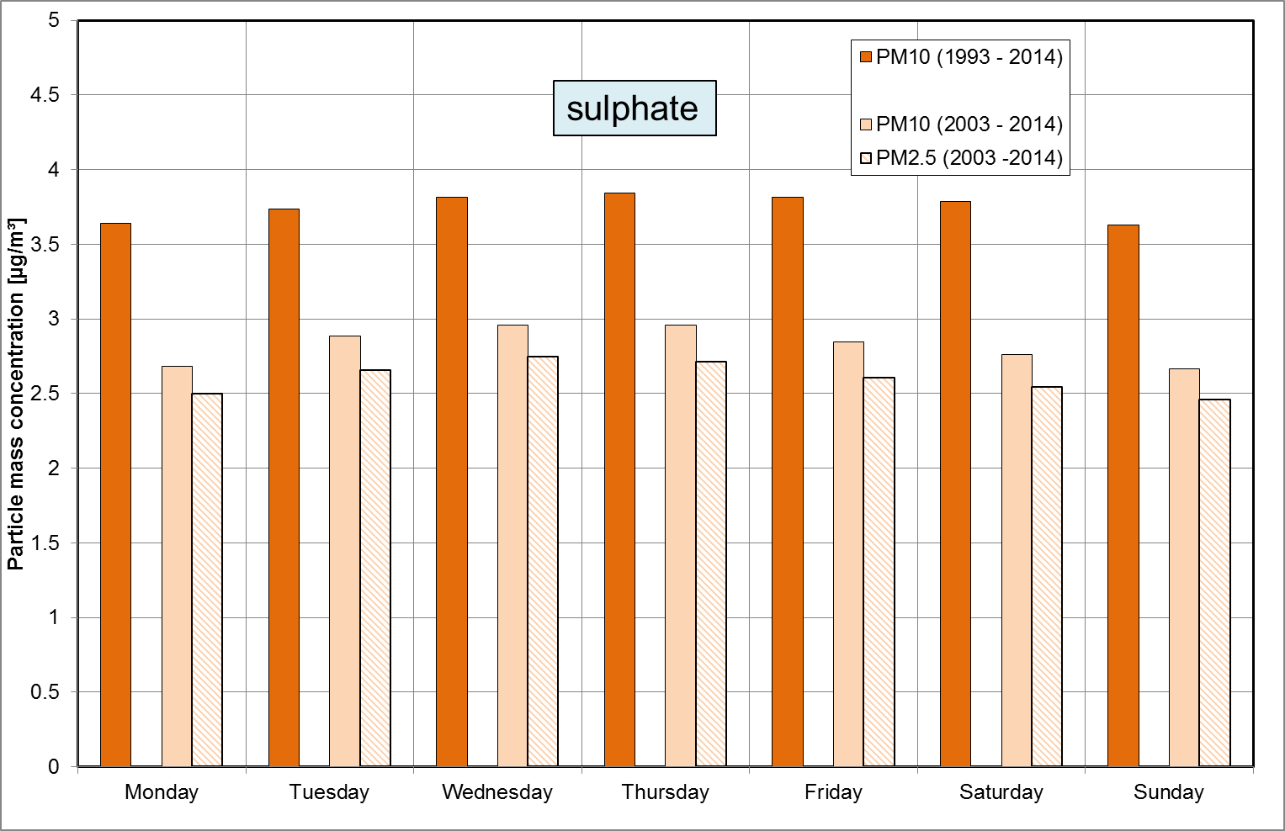
mass concentration average for week-days
1993 – 2014, PM₁₀ , 2003 – 2014 PM₁₀ and PM_{2.5}

Slide 23
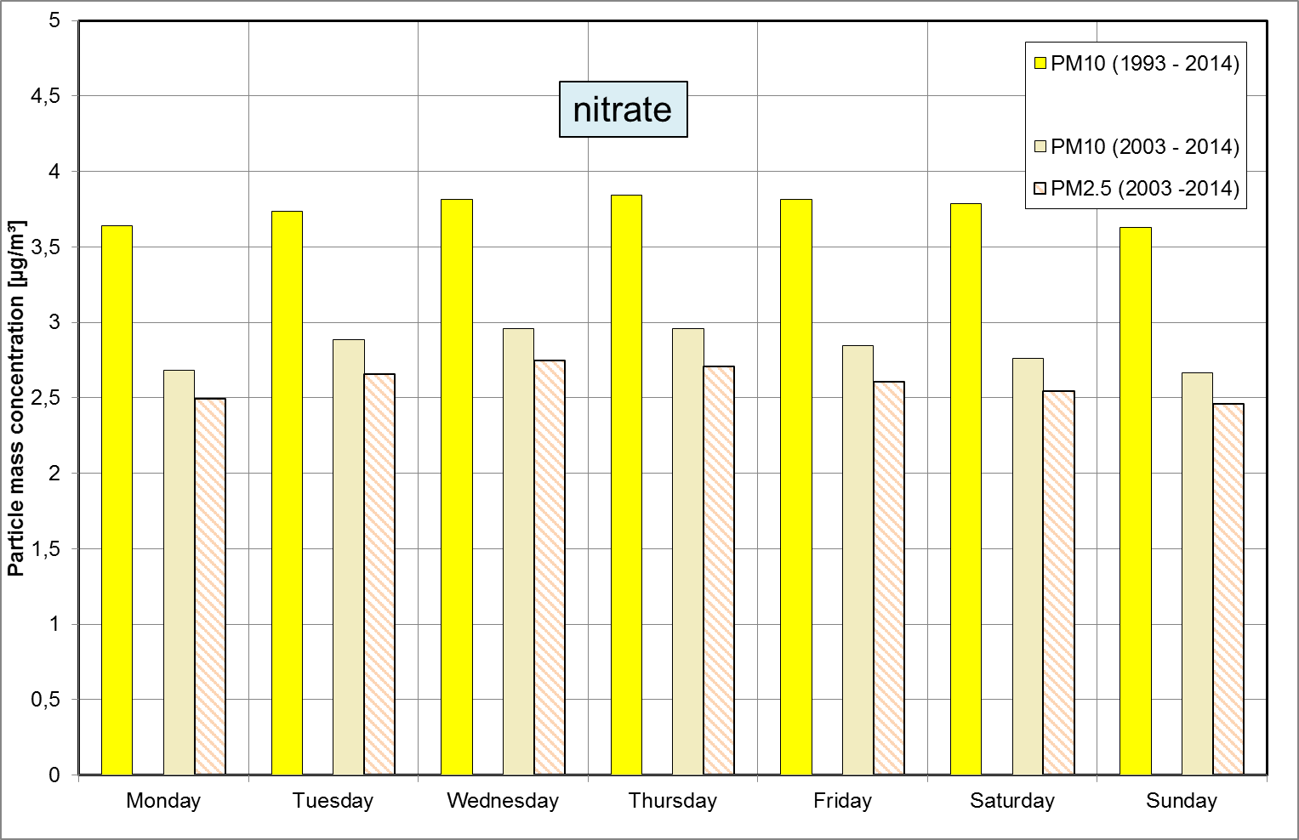
mass concentration average for week-days
1993 – 2014, PM₁₀ , 2003 – 2014 PM₁₀ and PM_{2.5}

Slide 24
Summary
The particle mass concentration PM₁₀ decreases since 1993 and
remains constant in the last 15 years around 22.3 µg/m³ (± 13%).
The highest particle mass concentrations (PM₁₀ and PM_{2.5}) were found for
easterly air-mass inflow in winter.
For sulphate the particle mass concentration decrease.
For nitrate the particle mass concentration remains more constant.
The highest EC concentration were found for WE.
EC shows general an decreasing trend, also for westerly air-mass inflow.
For all quarterly-periods PM₁₀ (1993 – 2014) decrease up to 2000, higher values found in the Quarter JFM.
The measurements in Melpitz are representative for a large area that is typical for East and North-East Germany. But the influence of week-day activities (traffic, production, agriculture) can by shown.

Slide 25

Thank you for attention!

